Slide 1

Weather Driven Sales Prediction
Regression Analysis

Slide 2

Overview
Walmart Challenge
Dataset Overview & Preparation
Regression Analysis
Conclusion
Q & A

Slide 3
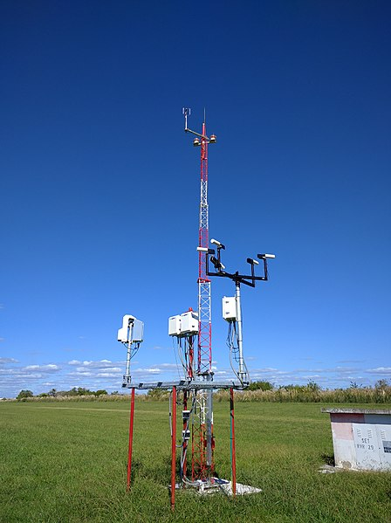

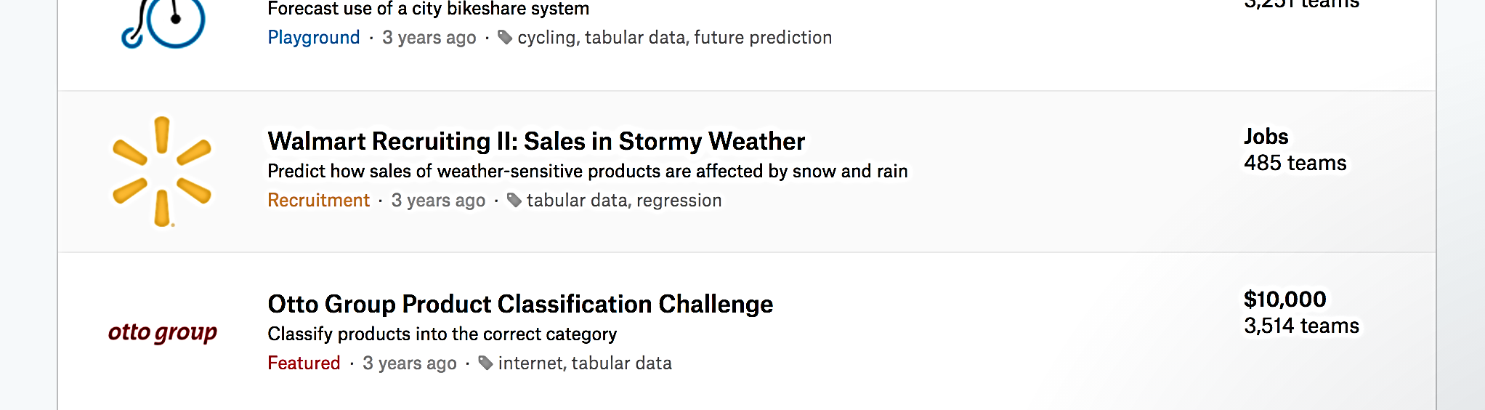
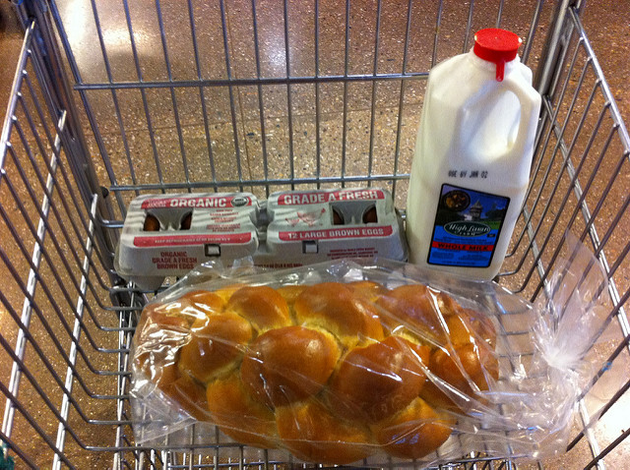

Walmart Challenge
Predict the sales of 111 potentially weather-sensitive products (like umbrellas, bread, and milk) around the time of major weather events at 45 of their retail stores
20 Automated Weather Observing System (AWOS) stations covering 45 stores
Daily weather measurements of 18 local climatological data
tmax | tmin | tavg | depart | dewpoint | wetbulb | heat | cool | sunrise
sunset | codesum | snowfall | preciptotal | stnpressure | sealevel | resultspeed | resultdir | avgspeed
Daily products sales per store
Duration from Jan 2012 to Oct 2014

Slide 4
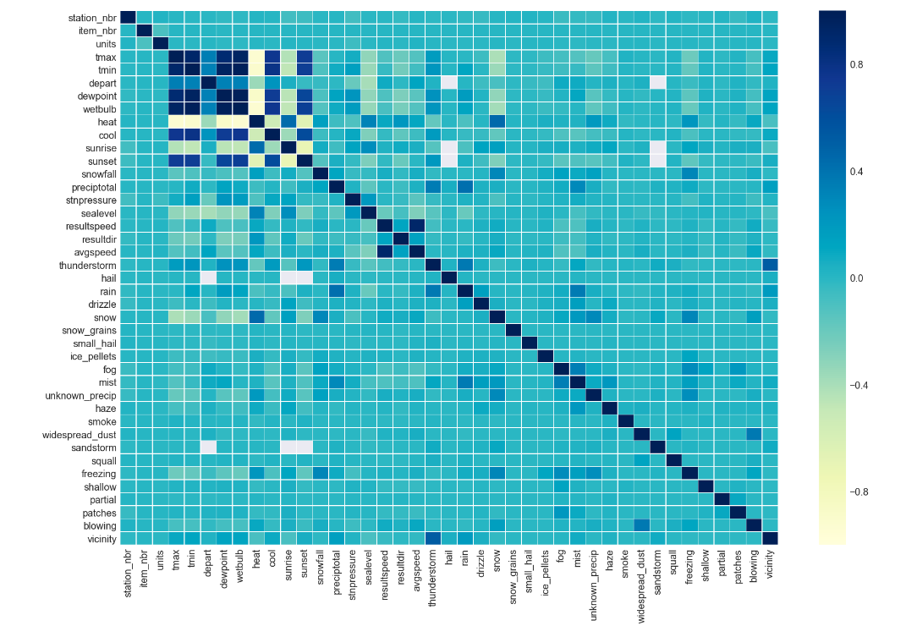
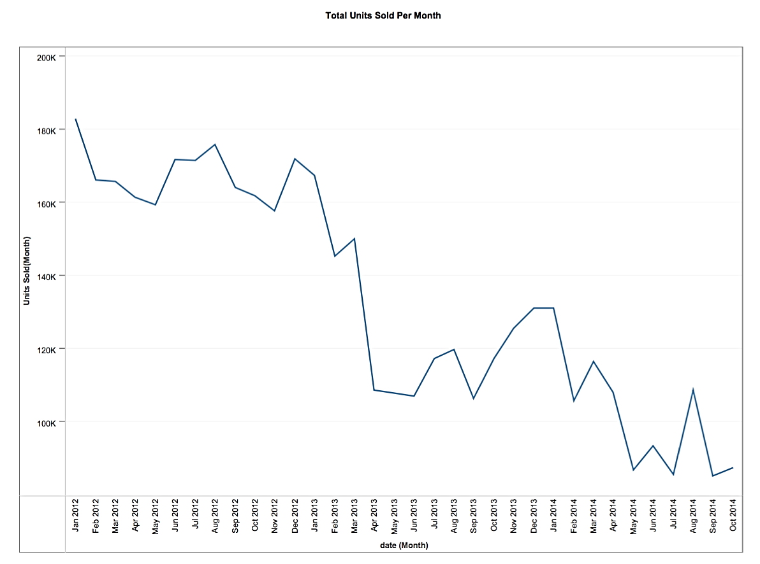
Dataset Overview
Declining sales trend
Minimal to moderate correlation between units and weather condition
Top 3
selling items
45, 5, and 9
Products masked into item numbers only to maintain their anonymity and reduce potential prediction bias

Slide 5

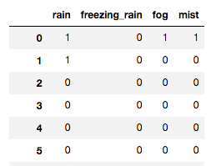
Data Preparation
Missing Data Filling by Interpolation
Using the surrounding days within the same station
Encoding weather phenomena flags
into 32 binary features
Expanded the weather features significantly from 18 to 49 feature
Items - Stores - Stations linking
The final combined clean DataFrame had a total of 2,038,737 rows and 41 columns
with 18,367 records per item

Slide 6
Multiple Regression Analysis

Slide 7
Multiple Regression Analysis
Train / Test
80 : 20
Fold 1
Fold 2
Fold 3
Fold 4
Fold 5

Slide 8
Multiple Regression Analysis
Forward
Backwards
Train / Test
80 : 20
Train / Test
80 : 20
Fold 1
Fold 2
Fold 3
Fold 4
Fold 5
Fold 1
Fold 2
Fold 3
Fold 4
Fold 5

Slide 9
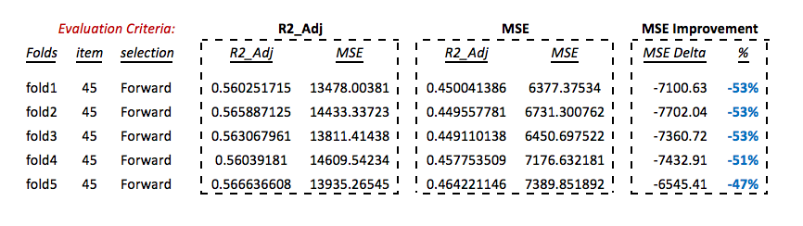
Multiple Regression Analysis
Forward
Backwards
Train / Test
80 : 20
Train / Test
80 : 20
Fold 1
Fold 2
Fold 3
Fold 4
Fold 5
Fold 1
Fold 2
Fold 3
Fold 4
Fold 5
R² Adjusted
R² Adjusted

Slide 10
Multiple Regression Analysis
Forward
Backwards
Train / Test
80 : 20
Train / Test
80 : 20
Fold 1
Fold 2
Fold 3
Fold 4
Fold 5
Fold 1
Fold 2
Fold 3
Fold 4
Fold 5
R² Adjusted
R² Adjusted
Over Fitting

Slide 11
Multiple Regression Analysis
Forward
Backwards
Train / Test
80 : 20
Train / Test
80 : 20
Fold 1
Fold 2
Fold 3
Fold 4
Fold 5
Fold 1
Fold 2
Fold 3
Fold 4
Fold 5
R² Adjusted | MSE
R² Adjusted | MSE

Slide 12
Multiple Regression Analysis
Forward
Backwards
Train / Test
80 : 20
Train / Test
80 : 20
Fold 1
Fold 2
Fold 3
Fold 4
Fold 5
Fold 1
Fold 2
Fold 3
Fold 4
Fold 5
R² Adjusted | MSE
R² Adjusted | MSE

Slide 13
Multiple Regression Analysis
Forward
Backwards
Train / Test
80 : 20
Train / Test
80 : 20
Fold 1
Fold 2
Fold 3
Fold 4
Fold 5
Fold 1
Fold 2
Fold 3
Fold 4
Fold 5
R² Adjusted | MSE
R² Adjusted | MSE

Slide 14



The Results

Slide 15
Optimum Prediction Models
Runtime
1 hr 40 mins
Optimum models serialized and saved
using ‘Pickle’ package for immediate prediction
Item | Quantity Sold | Selection
45 | 1,005,111 | Forward
9 | 916,615 | Forward
5 | 846,662 | Forward
44 | 577,193 | Backward
16 | 226,772 | Backward
Forward selection was better in predicting high sales items
Backward elimination was better in predicting low sales items
Final results had Backwards models selected for 101 items
and Forward models selected for 9 items

Slide 16
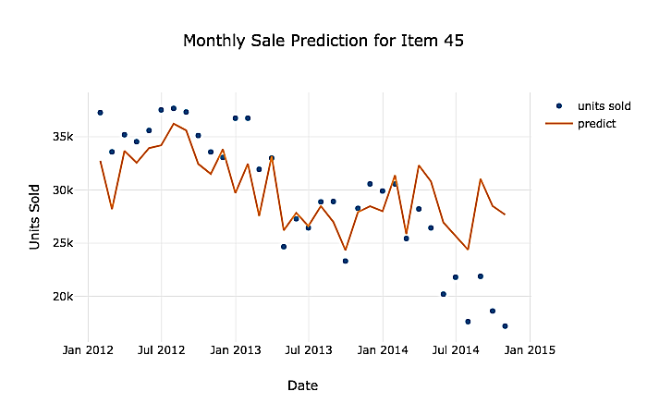
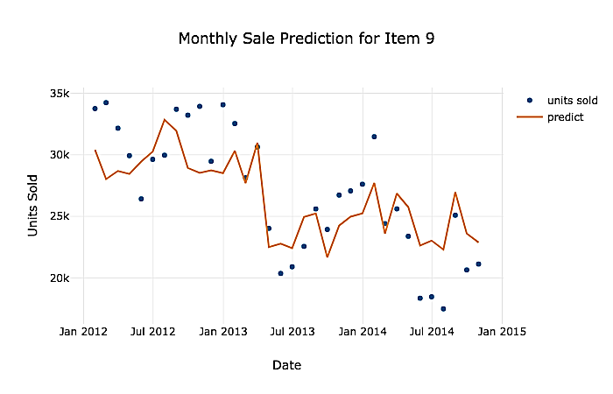
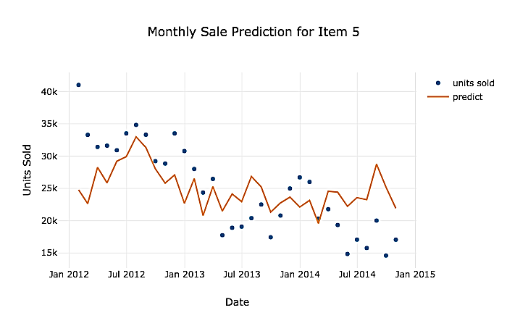
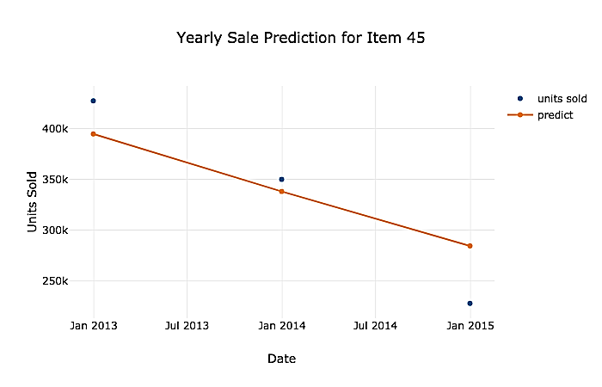
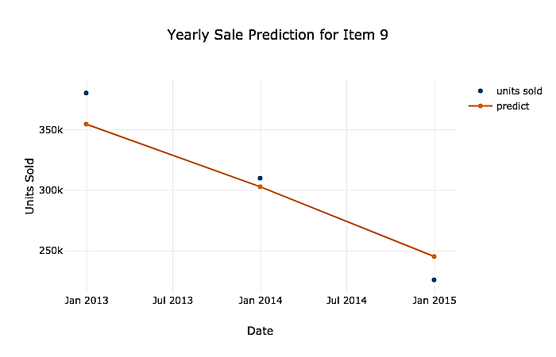
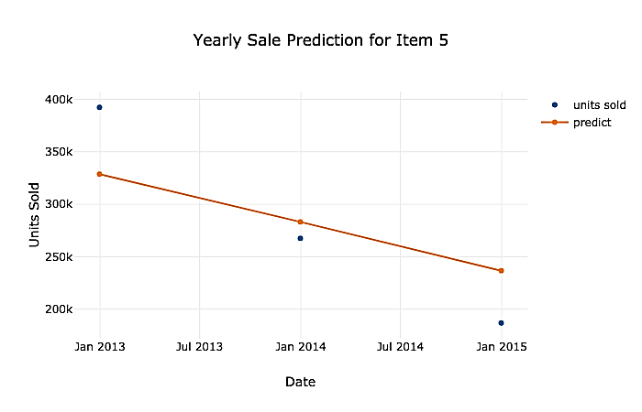
Top Three Items Prediction Results
Prediction models successfully captured the reducing sales seasonal trend
and produced moderately fitted prediction models.

Slide 17
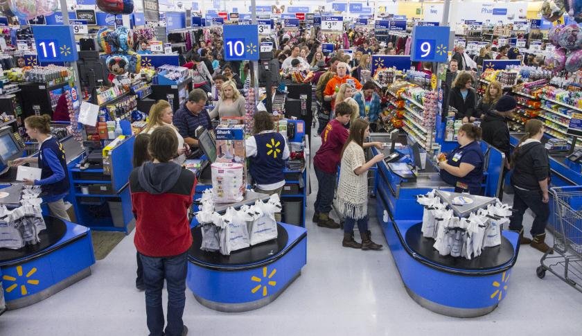
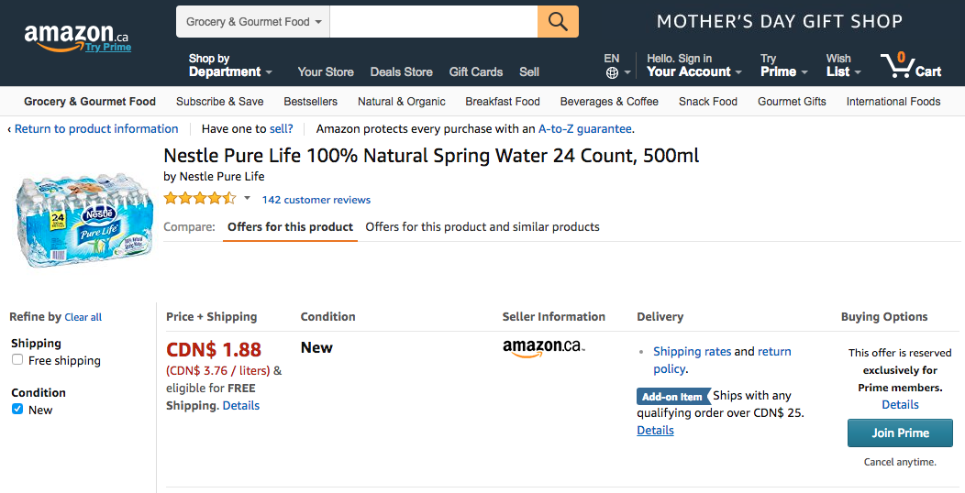
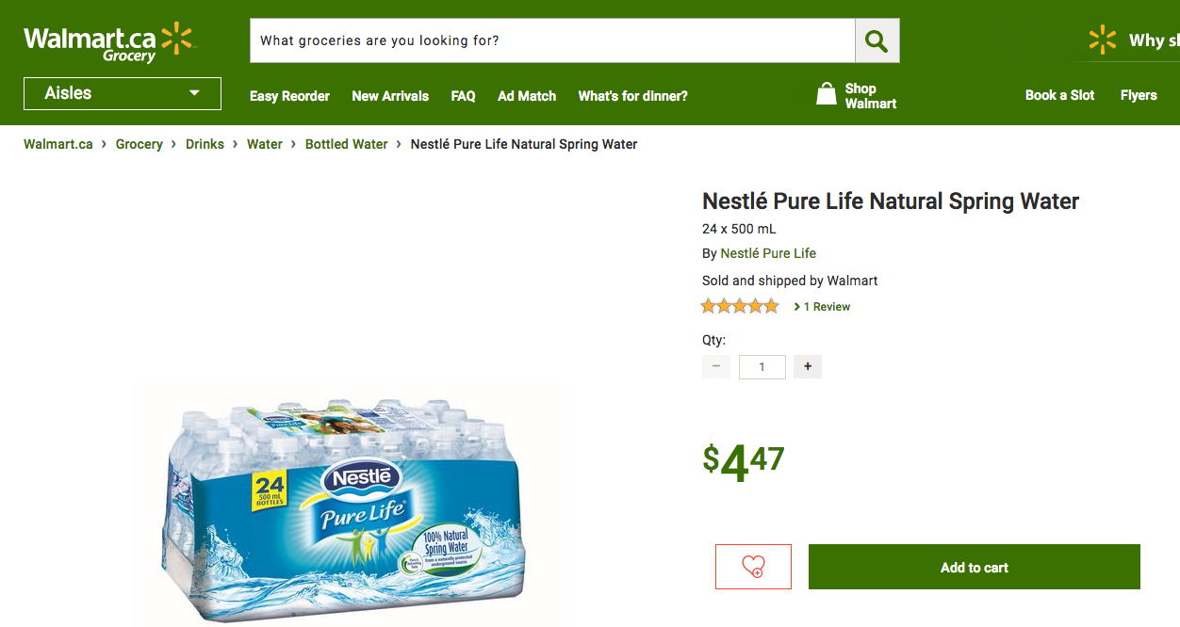
Conclusion
Weather may not be a great influencer to consumers buying behavior for basic products
weather based prediction models can be improved if combined with directly related consumer buying influencers
Day of week, holidays, paycheck days, promotions
Online competition

